Slide 1
Welcome to CS4222 PSLG!
With Robert and Jakub

Slide 2

Java 1D Arrays​
Used to store multiple values in a single variable, instead of declaring separate variables for each value.​
Declaration and initialization:​
String[] cars = {"Volvo", "BMW", "Ford", "Mazda"};​
Access:​
System.out.println(cars[0]);​
// Outputs Volvo

Slide 3
Problem 1
Write a Java program to declare and initialize an array of integers with 5 elements and then print out all the elements.

Slide 4
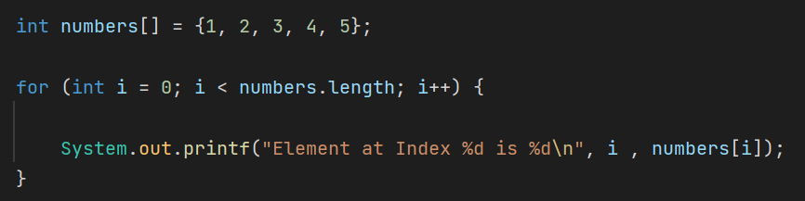
Answer:

Slide 5
Problem 2
Write a Java program to declare and initialize an array of Strings with 10 elements and then print them all out.

Slide 6
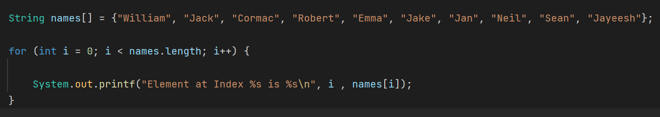
Answer:

Slide 7
Problem 3
Write a Java program to find the sum of all elements in a given 1D array of integers.​

Slide 8
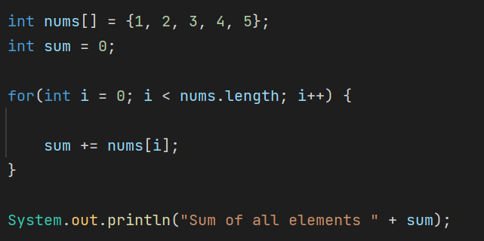
Answer:

Slide 9
Problem 4
Write a Java program to calculate the average value of the elements of an array.

Slide 10
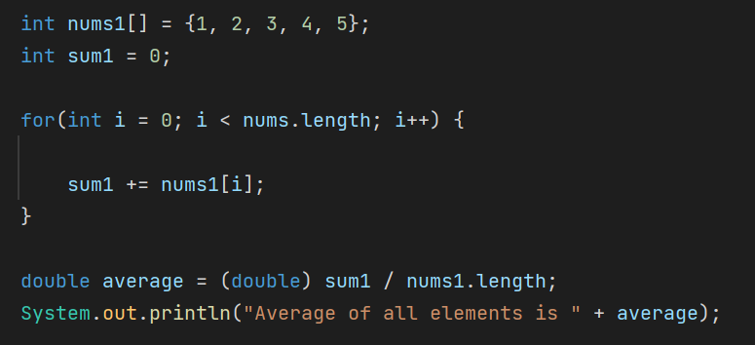
Answer:

Slide 11

Thank you for coming!

